Slide 1
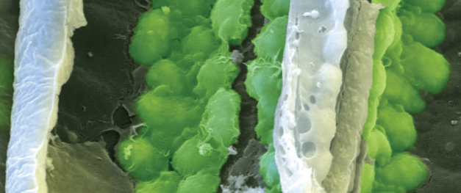
Chapter 9: Inside cells

Slide 2
Introduction
Biochemical processes are essential for life
Every living cell of every part of an organism needs matter and energy to keep it alive.
Unicellular organisms take in materials (inputs) from their external environment.
They use these materials inside their single cell.
Outputs or products of these activities are biomolecules and inorganic wastes.
The biomolecules form the structures that carry out tasks.

Slide 3
Internal cellular membranes control biochemical processes
Biochemical processes are essential for life
Compartmentalising a cell by having membrane-bound organelles creates specialised environments for specific functions.
A large number of activities can occur at the same time in a very limited space and under different conditions.
For example, chemical reactions in lysosomes break down compounds brought into the cell by using strong digestive enzymes in an acidic environment.
Enclosing them in a membrane prevents them destroying the cell.
Notes:
Similar to a factory, compartmentalising a cell by having membrane-bound organelles creates specialised environments for specific functions. A large number of activities can occur at the same time in a very limited space and under different conditions. For example, chemical reactions in lysosomes break down compounds brought into the cell by using strong digestive enzymes in an acidic environment. Enclosing them in a membrane prevents them destroying the cell. Specific chemical reactions can occur using only a handful of enzymes that can be concentrated and recycled in membrane-bound areas. Membrane-bound structures can concentrate reactants and store products.

Slide 4
Specific enzymes control biochemical pathways
Biochemical processes are essential for life
Thousands of chemical reactions that occur constantly in each living cell is called cellular metabolism.
Rate varies among organisms.
Metabolic reactions are controlled and regulated to:
  maintain cell functions
  meet the energy needs of the cell.
What is it that controls the type and duration of these reactions?
Notes:
These reactions need to occur at a rate that allows the cell to function.
Answer: Enzymes
Each step in the pathway is controlled by an enzyme.
Enzymes speeds up the rate of chemical reactions without undergoing any change itself.
Without enzymes the reactions would occur so slow as to hardly proceed at all.

Slide 5
Specific enzymes control biochemical pathways
Biochemical processes are essential for life
Intracellular enzymes occur inside cells.
They speed up and control metabolic reactions.
Extracellular enzymes are produced by cells. They work outside the cell, e.g. digestive enzymes break down food in the small intestines.

Slide 6
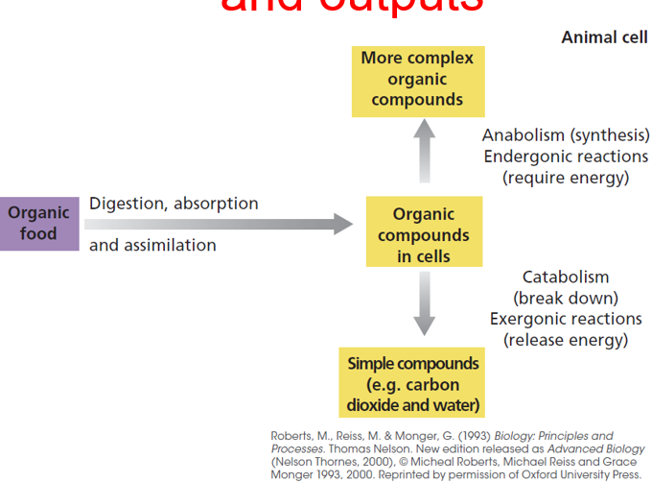
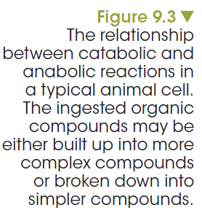
Biochemical processes involve energy inputs and outputs
Biochemical processes are essential for life
Notes:
Reactions that breakdown complex molecules to simpler fragments are called catabolic reactions. For example, starch polymer breaking down to simple glucose monomers.
Reactions that start with simple molecules to build more complex molecules are called anabolic reactions. For example, amino acids form a polypeptide chain.

Slide 7
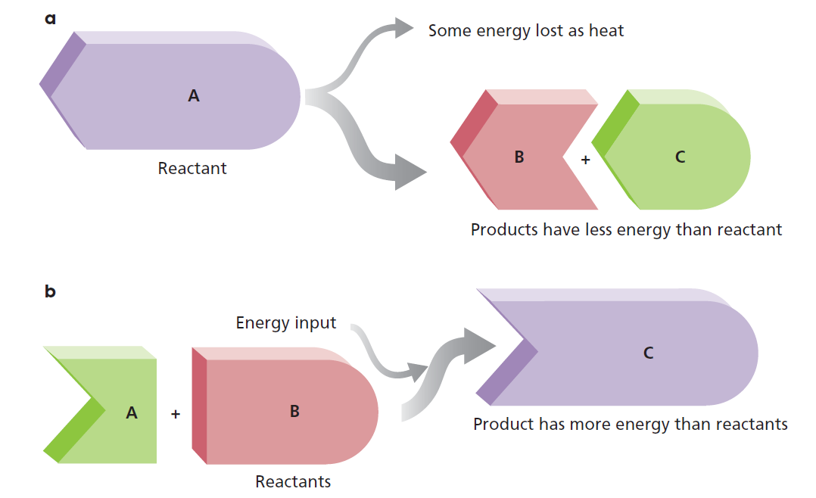
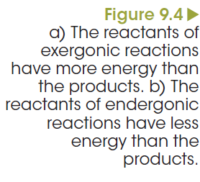
Biochemical processes involve energy inputs and outputs
Biochemical processes are essential for life
Notes:
Energy is required to make any reaction go. Exergonic reactions (‘exo’ = out) are those that release surplus energy as the reaction forms products. When molecular bonds are broken, energy is released. It makes sense that when a large molecule is broken down to smaller molecules, a large amount of energy is released. Therefore, catabolic reactions are exergonic reactions.
Reactions that require more energy to go are endergonic reaction (‘endo’ = in). When proteins are built up from amino acids, energy is used. Anabolic reactions are always endergonic. Cells use the available energy released from catabolic reactions to fuel anabolic reactions.
Putting it another way.
A biochemical process or reaction occurs when the chemical bonds of inputs or reactants are broken and the atoms recombine to form a new substance or substances, output or products.
In endergonic reactions, a total net amount of energy is absorbed and locked up in the new bonds of the products.
These have more stored energy than the reactants.
In exergonic reactions, a total net amount of energy is released from the bonds of the reactants and the products have less energy than the reactants.
There is energy to spare!

Slide 8
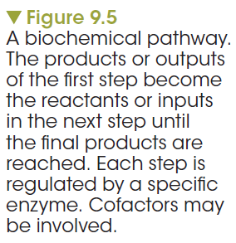
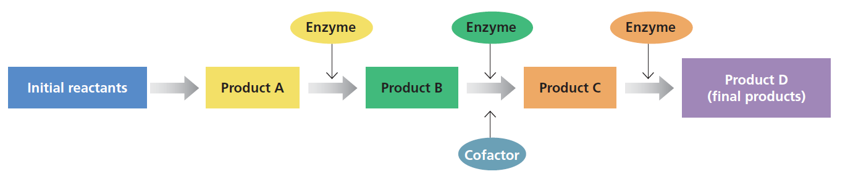
Biochemical processes involve energy inputs and outputs
Biochemical processes are essential for life
Notes:
Many cellular processes involve many reaction steps. At each step, reactants react to form new reactants, which themselves become reactants for the next step in the reaction chain, until the final products are formed.
Each step in these biochemical processes or pathways are often reversible, with the reaction favouring the formation of products.
If products build up and are not removed, the reaction might slow down to the point that the whole pathway is slowed.
Fortunately, the products formed at each step are consumed by the next step in the pathway, or are removed in a variety of ways, ensuring the reactions continue in the right direction.
Photosynthesis and respiration are two pathways controlled and regulated by enzymes.

Slide 9
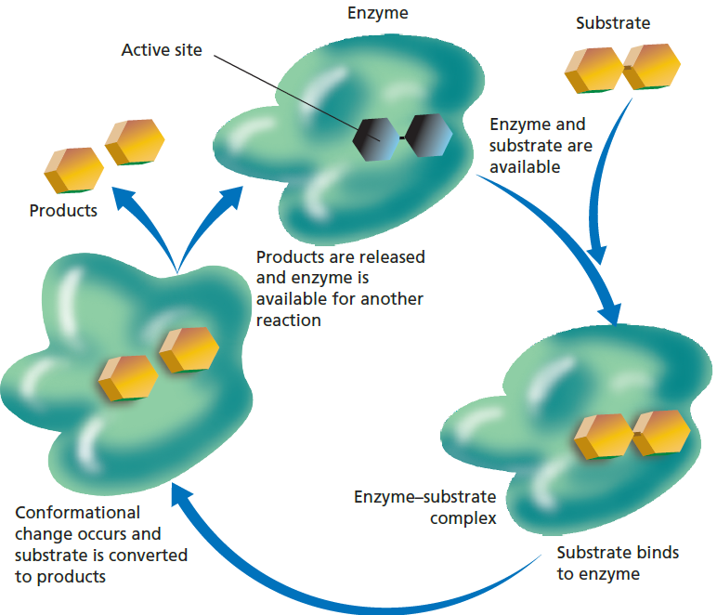
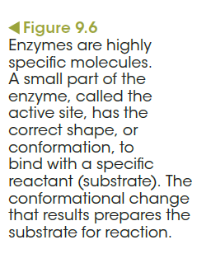
Properties of enzymes affect their specific functions
Notes:
Enzyme-assisted reactions.
Enzymes have an active site, a region that is precisely shaped to target a molecule or substrate.
The active site bring substrates close to each other in an enzyme-substrate complex.
This is where the reaction occurs to form the new product. The enzyme is not consumed in the interaction.

Slide 10
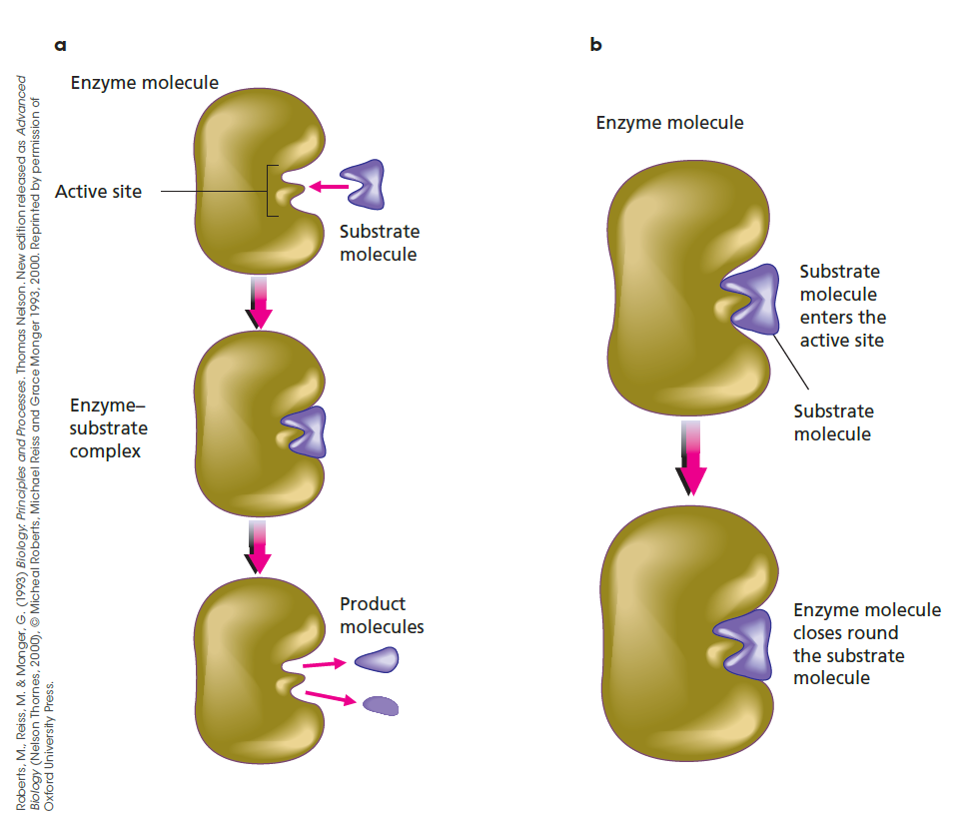
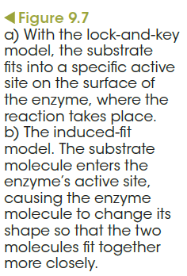
Properties of enzymes affect their specific functions
Notes:
Two models describe the enzyme substrate interaction:
Lock-and-key model. The substrate is an exact fit for the enzyme active site.
Induced-fit model of enzyme action. Bonds that form between an enzyme and its substrate can modify the shape of the enzyme so that the substrate can be fully accommodated by the enzyme.
Bonds within the substrate molecule are stretched and bent by the molecular interactions with the amino acid groups that line the active site.
Bond stresses on the substrate, lowering the activation energy required to kick-start the reaction.
New products form at a fast rate.

Slide 11
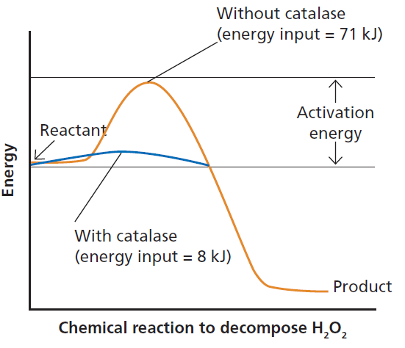
Enzymes can work rapidly
Properties of enzymes affect their specific functions
catalase
2H₂O₂ → 2H₂O + O₂
Fe³⁺
Notes:
One of the fastest enzymes is catalase. This enzyme is found in several organs and tissues, including the liver, where its job is to speed up the breakdown of hydrogen peroxide (H2O2) into oxygen and water.
Note that the enzyme has lowered the activation barrier. That is, the activation energy required to start the reaction is considerably reduced. This means that many reactions can occur at lower temperatures – for example, within a normal physiological temperature range. For mammals this would be 37 degrees celsius.

Slide 12
Enzymes
Properties of enzymes affect their specific functions
Enzymes are not destroyed or altered by reactions.
Enzymes can work in either direction (reversible).
  One direction may be more favourable than the other.
  Unfavourable direction occurs using a different
  enzyme-controlled reaction.
  These types of reactions are equilibrium reactions.

Slide 13
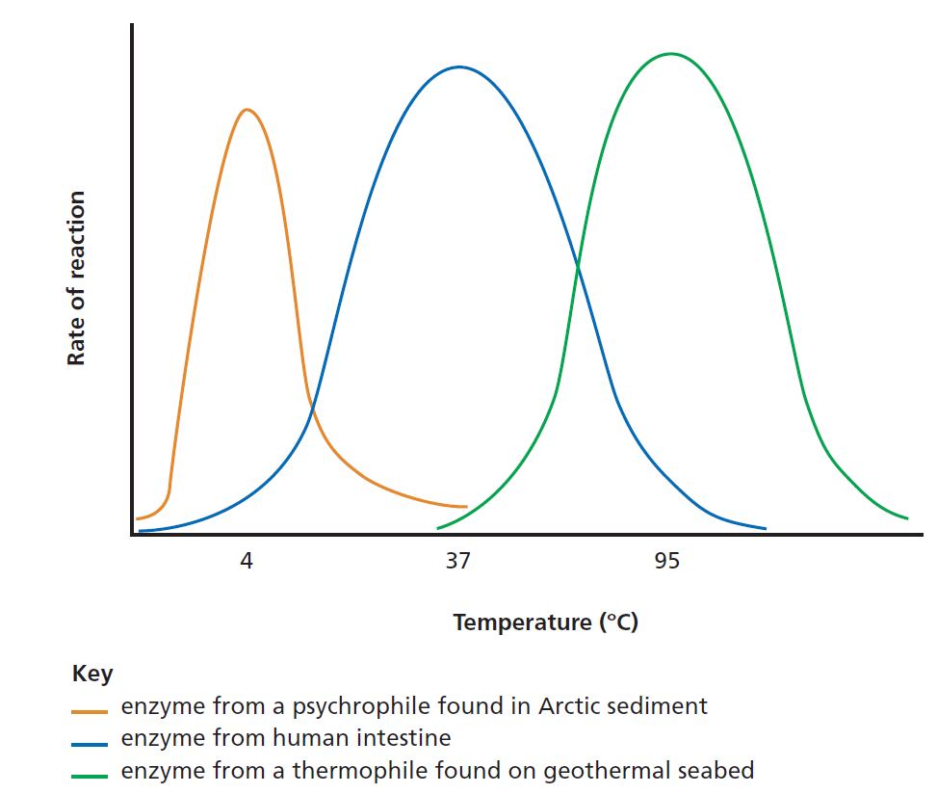
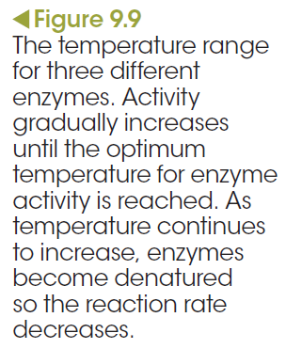
Enzymes are affected by temperature
Factors that affect enzyme activity
Notes:
Enzymes are affected by temperature and have an optimal range in which they operate. The temperatures that enzymes work best in are the temperatures of the environment they can be found in. For example, enzymes operating in the human body work best at temperatures of around 37°C (Figure 9.9), which is the relatively constant core temperature of the body. The enzymes of psychrophiles (or cryophiles), micro-organisms that live in near-freezing environments such as the wind-blasted rocks of snow-covered mountain summits, can operate at very low temperatures. This may be caused by the loss of some of the bonds that keep the protein rigidly folded. Having a more flexible structure means enzymes require less energy to work. The micro-organism Pyrodictium exists in geothermal-heated areas of the sea floor. It is a thermophile and its enzymes operate best at temperatures of around 95–105°C.

Slide 14
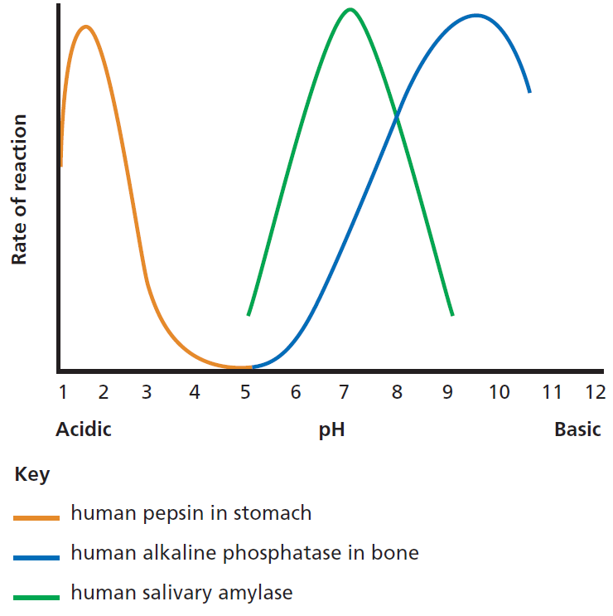
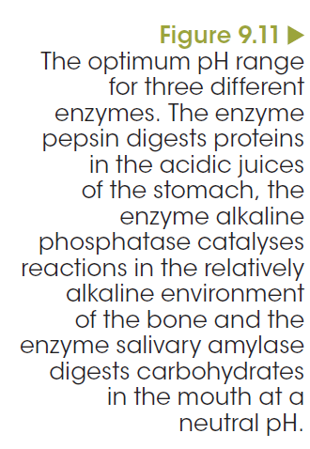
Enzymes are affected by pH
Factors that affect enzyme activity
Notes:
The optimum pH range for three different enzymes: the enzyme pepsin digests proteins in the acidic juices of the stomach, the enzyme alkaline phosphatase catalyses reactions in the relatively alkaline environment of the bone and the enzyme salivary amylase digests carbohydrates in the mouth at a neutral pH.
Enzyme-limiting reaction
The effect of increases in substrate concentration on the rate of an enzyme-catalysed reaction.
At saturation, further increases in substrate concentration do not increase the rate of the reaction.
Substrate limiting reaction
When the amount of enzyme in a system is increased, then the amount of product increases exponentially.
This keeps on happening until the product starts to inhibit enzyme action or the substrate is depleted.
3. The rate of reaction is proportional to the enzyme concentration provided there is excess substrate present.

Slide 15
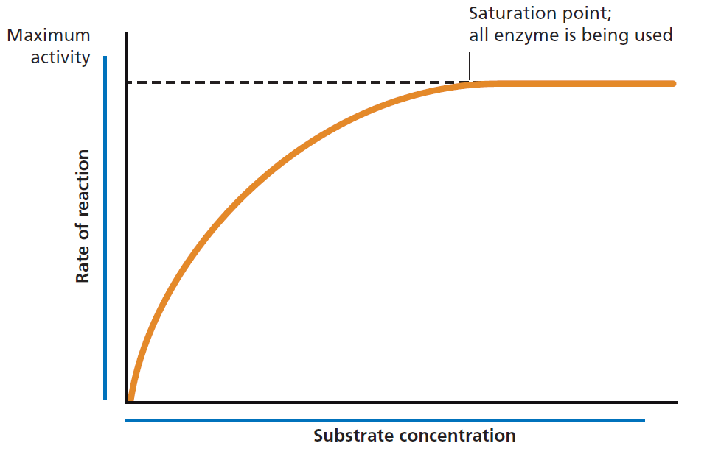
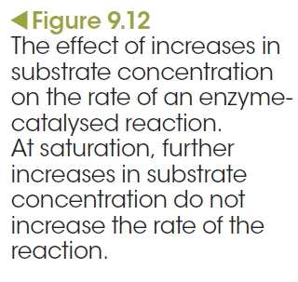
Substrate and enzyme concentration can affect enzyme activity
Factors that affect enzyme activity
Notes:
Enzyme-limiting reaction
The effect of increases in substrate concentration on the rate of an enzyme-catalysed reaction.
At saturation, further increases in substrate concentration do not increase the rate of the reaction.
Substrate limiting reaction
When the amount of enzyme in a system is increased, then the amount of product increases exponentially.
This keeps on happening until the product starts to inhibit enzyme action or the substrate is depleted.
3. The rate of reaction is proportional to the enzyme concentration provided there is excess substrate present.

Slide 16
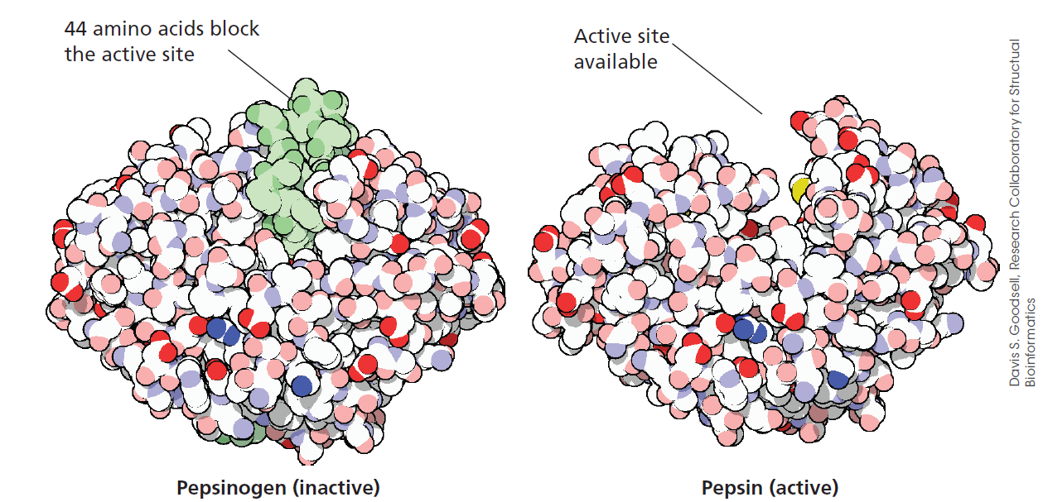
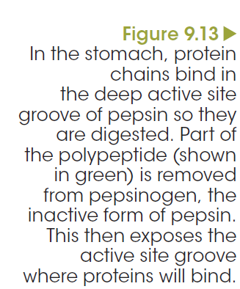
Active site and inhibitors
Factors that affect enzyme activity

Slide 17
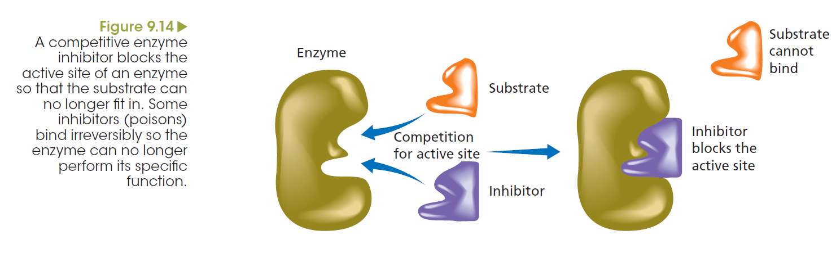
Enzymes may be inhibited by substrates
Factors that affect enzyme activity
Notes:
Non-competitive inhibitor
The activity of almost every enzyme in a cell is regulated by feedback inhibition, in which the product of a reaction can inhibit enzyme activity.
Inhibitor binds to a site on the enzyme, other than the active site, thus slowing the rate of reaction.
When the inhibitor binds to the enzyme, the active site of the enzyme changes shape so that it no longer has an affinity for its substrate.
If the product is removed, then inhibition will be reduced and the product will be produced again.
This helps cells keep the concentration of products within a certain range.
Competitive inhibitor
Other substrates compete with the natural substrate for space in the active site.

Slide 18
Enzymes may need to be activated
Factors that affect enzyme activity
Coenzymes are non-protein organic substances that are required for enzyme activity.
  Relatively small molecules compared to the enzyme.
  Dietary vitamins act as carriers of substances to and from catalytic reactions.
Cofactors are small inorganic substances, such as zinc and magnesium ions.

Slide 19
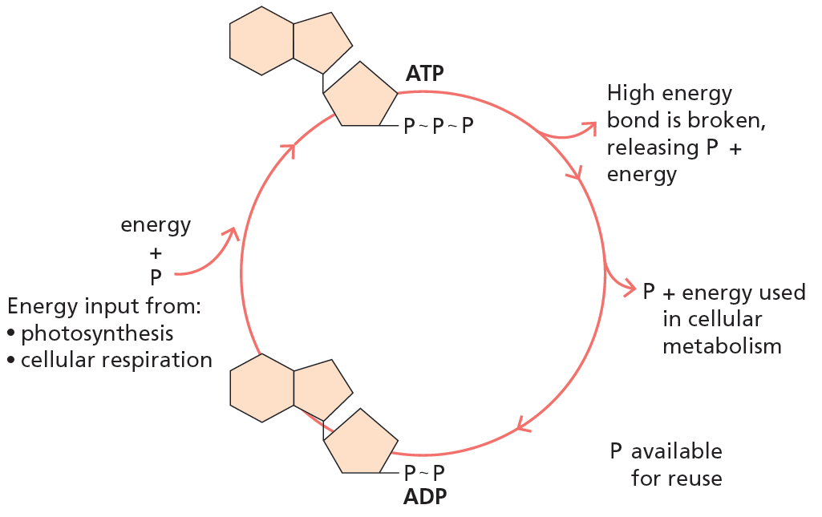
ATP
Energy is transferred between reactions
The ATP–ADP cycle shuttles energy between reactions
Notes:
Cells use the chemical energy released from exergonic reactions to fuel endergonic reactions.
This transfer is achieved by a molecule called adenine triphosphate (ATP).
ATP is a nucleotide containing adenosine attached to a sugar group (ribose), which is bound to a chain of three phosphate groups.
ATP is readily moved around the cell.
ATP is an energy carrier in all living cells. It couples energy-releasing reactions with energy requiring ones.
Hydrolysis of ATP removes the 3rd phosphate from the molecule and releases energy.
This leave adenine diphosphate (ADP) and a free inorganic phosphate.
This reaction is sped up by the enzyme ATPase.

Slide 20
ATP-ADP Cycle
Cells use the chemical energy released from exergonic reactions to fuel endergonic reactions.
This transfer is achieved by a molecule called adenine triphosphate (ATP).
ATP is a nucleotide containing adenosine attached to a sugar group (ribose), which is bound to a chain of three phosphate groups.
ATP is readily moved around the cell.
ATP is an energy carrier in all living cells. It couples energy-releasing reactions with energy requiring ones.
Hydrolysis of ATP removes the 3rd phosphate from the molecule and releases energy.
This leave adenine diphosphate (ADP) and a free inorganic phosphate.
This reaction is sped up by the enzyme ATPase.

Slide 21
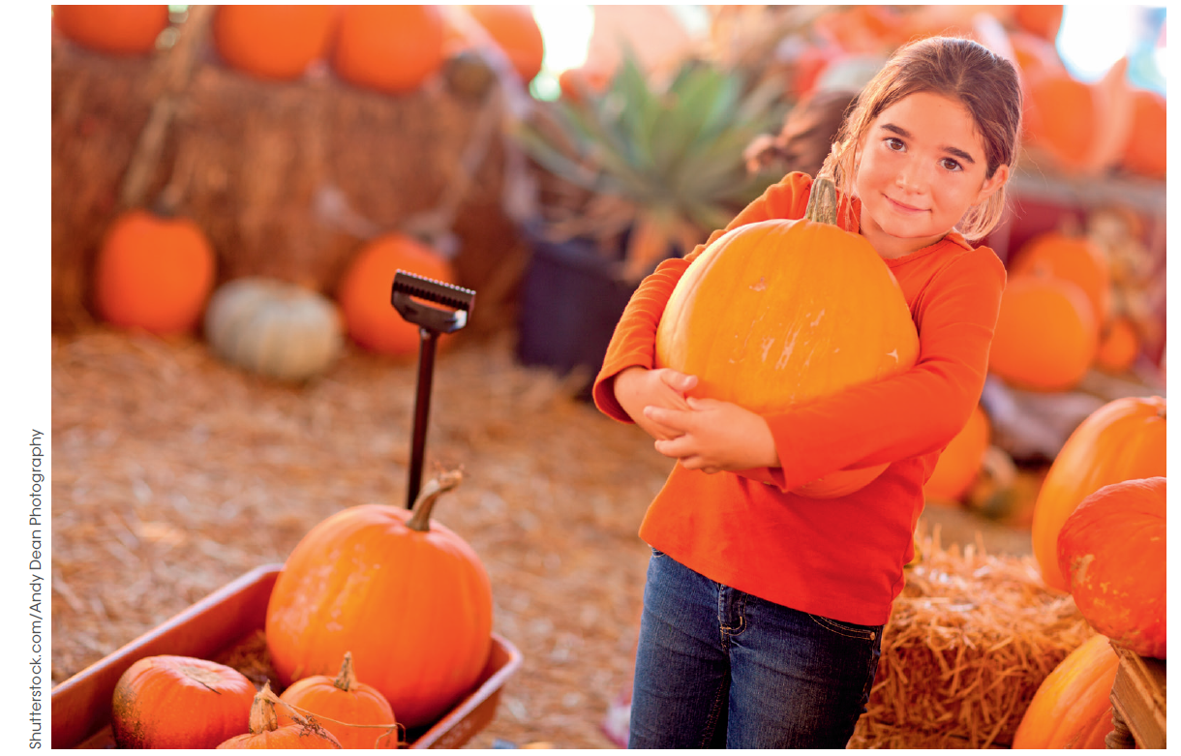
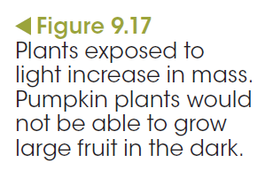
Photosynthesis is a series of steps
Photosynthesis
The equation is the net reaction of all steps:
carbon dioxide + water → glucose + oxygen + water
6CO₂ + 12H₂O → C₆H₁₂O₆ + 6O₂ + 6H₂O

Slide 22
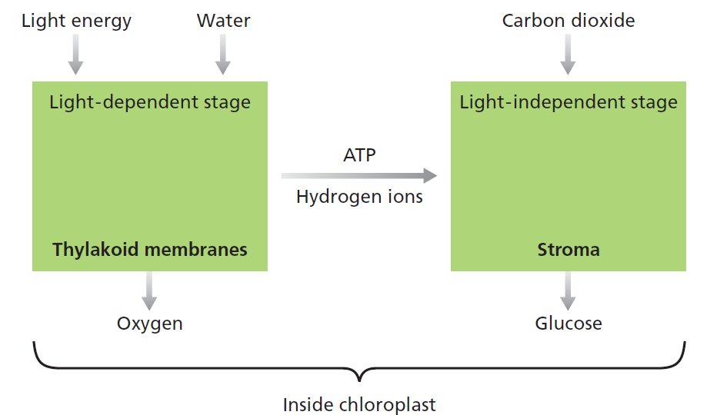
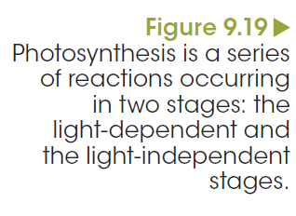
Photosynthesis is a series of steps
Photosynthesis
Chloroplasts
The light-dependent stage
The light-independent stage
Notes:
Chloroplasts
Chloroplasts are the site of photosynthesis.
The stroma is a gel like matrix rich in enzymes, enclosed by the inner membrane.
Suspended in the stroma is the thylakoid membranes.
These are flat, sac-like structures that are called grana when grouped together into stacks.
Light dependent stage
Light energy is absorbed by different pigments within the thylakoid membranes.
These pigments include chlorophylls (green), carotenoids (orange) and xanthophylls (yellow).
Chlorophylls absorb the wavelengths of blue and red light, and they reflect the green wavelengths.
When a chlorophyll molecule in the thylakoid membrane absorbs light energy, electrons within the molecule become energised.
The energy is used to split water molecules (H₂O) into hydrogen ions (H⁺) and oxygen gas (O₂).
ATP molecules are formed in this stage.
Light independent stage
Occur in the stroma of the chloroplast.
In this reaction glucose molecules are produced from carbon dioxide.
This reaction requires a supply of carbon dioxide gas, hydrogen ions and chemical energy in the form of ATP.
ATP provide the chemical energy for the conversion of carbon dioxide to glucose molecules.
Many chemical reactions are involved in both the light-dependent and light-independent stages of photosynthesis.
Sucrose, starch and cellulose are polymers of glucose molecules produced in photosynthesis.

Slide 23
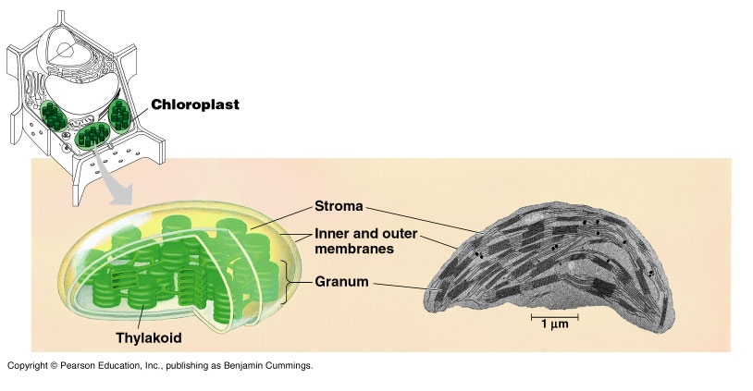
Chloroplasts
Chloroplasts are the site of photosynthesis.
The stroma is a gel like matrix rich in enzymes, enclosed by the inner membrane.
Suspended in the stroma is the thylakoid membranes.
These are flat, sac-like structures that are called grana when grouped together into stacks.

Slide 24
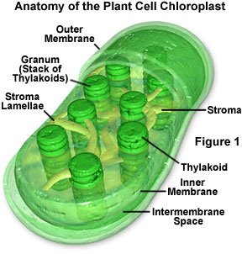
PHOTOSYNTHESIS
Why do we see green?
  Green color from white light reflected NOT absorbed
  Chloroplast: organelle responsible for photosynthesis
    Chlorophyll: located within Chloroplast
      Green pigment

Slide 25
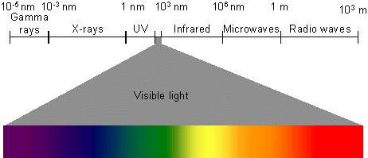
Visible light is only a small part of the electromagnetic spectrum (all forms of light).

Slide 26
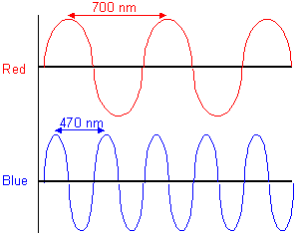
LIGHT behaves as if it were composed of "units" or "packets" of energy that travel in waves. These packets are photons.
The wavelength of light determines its color.

Slide 27
Absorption of Chlorophyll
Absorption
violet blue green yellow orange red
wavelength

Slide 28
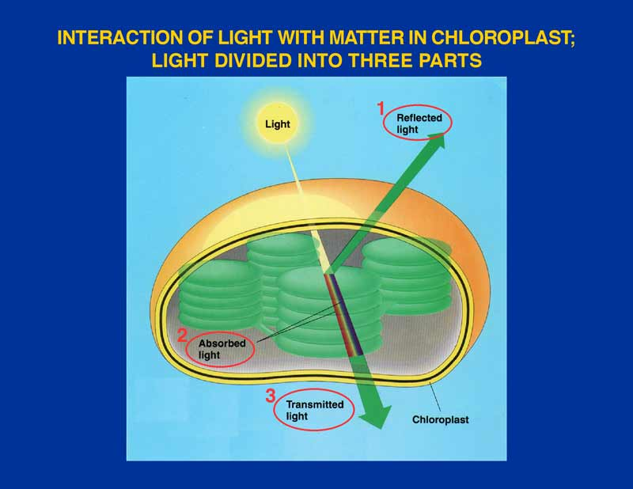

Slide 29
PHOTOSYNTHESIS
2 Phases
  Light-dependent reaction
  Light-independent reaction (Calvin Cycle)
Light-dependent: converts light energy into chemical energy; produces ATP molecules to be used to fuel light-independent reaction
Light-independent: uses ATP produced to make simple sugars.

Slide 30
Light dependent stage
Light energy is absorbed by different pigments within the thylakoid membranes.
These pigments include chlorophylls (green), carotenoids (orange) and xanthophylls (yellow).
Chlorophylls absorb the wavelengths of blue and red light, and they reflect the green wavelengths.
When a chlorophyll molecule in the thylakoid membrane absorbs light energy, electrons within the molecule become energised.
The energy is used to split water molecules (H₂O) into hydrogen ions (H⁺) and oxygen gas (O₂).
ATP molecules are formed in this stage.

Slide 31
PHOTOSYNTHESIS
Light independent stage
Occur in the stroma of the chloroplast.
In this reaction glucose molecules are produced from carbon dioxide.
This reaction requires a supply of carbon dioxide gas, hydrogen ions and chemical energy in the form of ATP.
ATP provide the chemical energy for the conversion of carbon dioxide to glucose molecules.
Many chemical reactions are involved in both the light-dependent and light-independent stages of photosynthesis.
Sucrose, starch and cellulose are polymers of glucose molecules produced in photosynthesis.

Slide 32
Cellular respiration
Aerobic cellular respiration:
glucose + oxygen → carbon dioxide + water + ATP
C₆H₁₂O₆ + 6O₂ → 6CO₂ + 6H₂O + 36 ATP
Notes:
All organisms, with the exception of the Archaea, use glucose as the primary source of energy for cellular metabolism.
The chemical bonds in glucose are broken, releasing energy in the form of ATP.
The word ‘aerobic’ is used when oxygen is present.
For all organisms, the breakdown of glucose to supply the cell with available energy, regardless of whether oxygen is present or not, starts with a biochemical pathway called glycolysis.

Slide 33
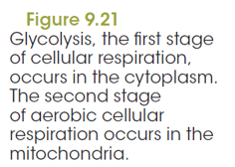
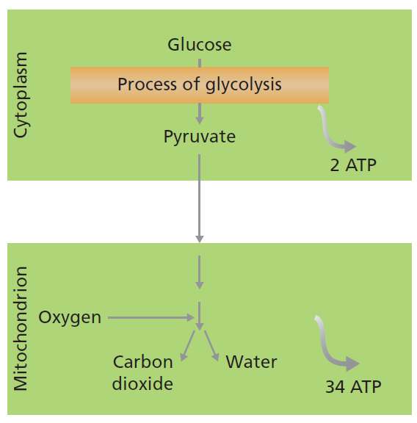
Cellular respiration
Stage 1 Glycolysis
Glycolysis takes place in the cytosol
Ten reactions, with each step controlled by a specific enzyme.
The initial reactant is glucose
Final product is two molecules of pyruvate.
Glycolysis produces a net of two ATP molecules that may be used by the cell as a source of energy.
Notes:
Glycolysis
Glycolysis takes place in the cytosol
Ten reactions, with each step controlled by a specific enzyme.
The initial reactant is glucose
Final product is two molecules of pyruvate.
Glycolysis produces a net of two ATP molecules that may be used by the cell as a source of energy.
Cellular respiration with oxygen
Pyruvate is a substrate in another set of reactions to extract energy, depending on the organism’s requirements and whether oxygen is present or absent. Two molecules of pyruvate formed in glycolysis enter the mitochondrion.
Mitochondria are small, regularly shaped structures found scattered throughout the cell’s cytosol.
Second series of steps within the mitochondria, after which carbon dioxide molecules and water are produced.
From all the reactions associated with aerobic cellular respiration, it is possible to produce a net 36 ATP molecules in one cycle.

Slide 34
Stage 2 Cellular respiration with oxygen
The two molecules of pyruvate formed in glycolysis enter the mitochondrion.
Mitochondria are small, regularly shaped structures found scattered throughout the cell’s cytosol.
A second series of steps occur within the mitochondria, after which carbon dioxide molecules and water are produced.
From all the reactions associated with aerobic cellular respiration, it is possible to produce a net 36 ATP molecules in one cycle.

Slide 35
Cellular respiration without oxygen
Cellular respiration
Alcohol fermentation:
glucose → ethanol + carbon dioxide + ATP
C₆H₁₂O₆ → 2CH₃CH₂OH + 2CO₂ + 2ATP
Notes:
Prokaryotes have evolved many anaerobic pathways given their existence in oxygen-free environments.
Eukaryotes commonly use two forms, which are referred to as alcohol fermentation and lactic acid fermentation.
Many micro-organisms, including yeast and some bacteria, carry out anaerobic cellular respiration.
The products of alcohol fermentation are carbon dioxide and ethanol, an alcohol.
Humans make use of these metabolic waste products in the production of wine, beer and bread. Plants cannot make use of ethanol. It cannot converted into carbohydrate and cannot be broken down in the presence of oxygen.
Furthermore, alcohol is toxic to cells. Many plants (or parts of plants) and yeast can respire anaerobically for a short time.
However, the rising concentration of ethanol is toxic. Yeast is a classic example of an anaerobic organism, which is used in the brewing and wine-making industries. However yeast grow better in aerobic conditions.
A major focus of the brewing industry is to develop new strains of yeast that are tolerant to high concentrations of ethanol.

Slide 36
Cellular respiration without oxygen
Cellular respiration
Lactic acid fermentation:
Anaerobic respiration
glucose → lactic acid + ATP
C₆H₁₂O₆ → 2CH₃CH(OH)COOH + 2ATP
Notes:
Lactic acid is the end product of anaerobic respiration in animals.
During strenuous exercise, energy production is required faster than our bodies can deliver oxygen to our working muscles.
The working muscles generate energy anaerobically with a build-up of lactic acid.
However, the muscles are in oxygen debt.
This debt must be repaid once the strenuous exercise slows down.
Oxygen availability converts lactic acid back to pyruvate, allowing continued aerobic metabolism.
Lactic acid fermentation is an important pathway for energy production.

Slide 37
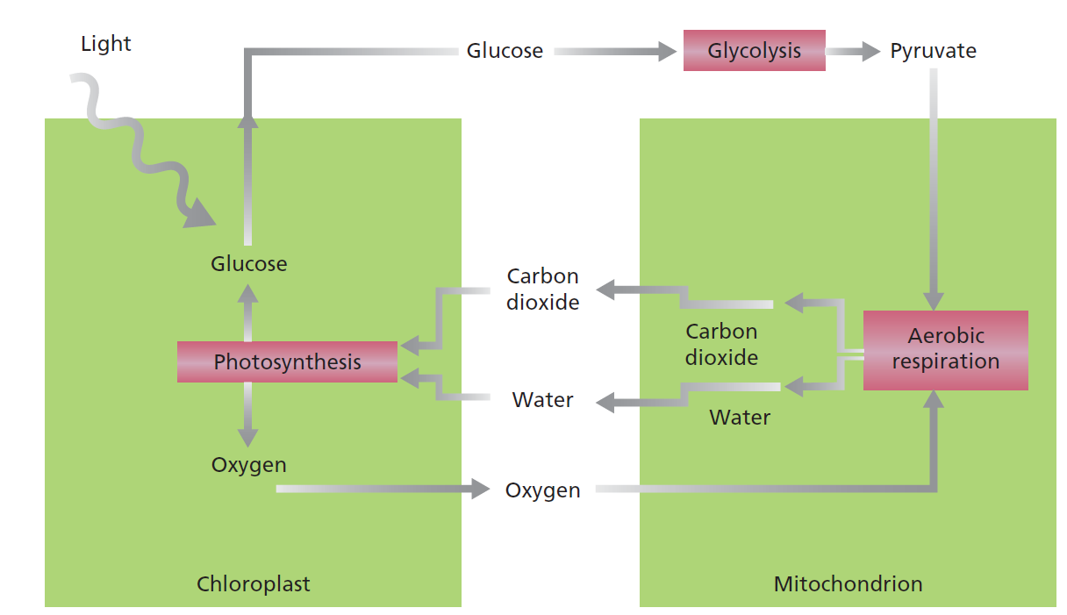
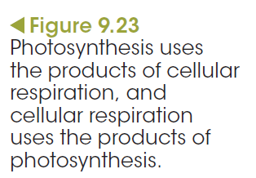
Photosynthesis and aerobic cellular respiration are closely related and interdependent
Cellular respiration
Notes:
The outputs of photosynthesis are the inputs of aerobic cellular respiration. Similarly, the outputs of aerobic cellular respiration are the inputs of photosynthesis. In plants and other autotrophs, the two processes can occur in the same individual cells when both chloroplasts and mitochondria are present. But many cells in green plants, such as root cells, do not have chloroplasts. These cells, and those of heterotrophs, depend on the products of photosynthesis to carry out cellular respiration. Thus, there is a dependency between autotrophs and heterotrophs.

